Slide 1





Funded by the European Union. Views and opinions expressed are however those of the author(s) only and do not necessarily reflect those of the European Union or the European Education and Culture Executive Agency (EACEA). Neither the European Union nor EACEA can be held responsible for them.
Project Number: 2024-1-CY01-KA210-ADU-000253720

Slide 2




ABOUT:
PROJECT RESULTS:
The TOGETHE WE CAN Project is dedicated to supporting parents and guardians of children with ADHD, equipping them with the knowledge and tools to foster greater social inclusion for their children. The Project aims to develop a specialised training package that addresses the unique challenges faced by children with ADHD. Additionally, the project provides comprehensive educational materials for adult trainers working on ADHD-related topics, empowering them to deliver impactful training sessions.
Training Methodology defining the structure and content of the specialised training package, Training program and training Materials.
Educational Program and Material for Parents/Guardians of
Children with ADHD
Customised to unique ADHD behaviours
Pilot Training Activity for Parents/Guardians of Children with ADHD in Greece

Slide 3
Module 1: Building Daily Routines & Time Management
Module Aim
Learning Objectives
Recognise common barriers to establishing routines for children with ADHD, and apply strategies to overcome them.
Estimate realistic times and manage transitions between activities.
Use step-by-step planning techniques and adopt tools (visual timetables, calendars, checklists) to support routines.
Design and adapt personalised morning, homework, and bedtime routines suited to their child’s needs.
The aim of this module is to help parents/co-guardians develop structured, consistent daily routines that reduce stress, support predictability, and improve time-management for children with ADHD.

Slide 4
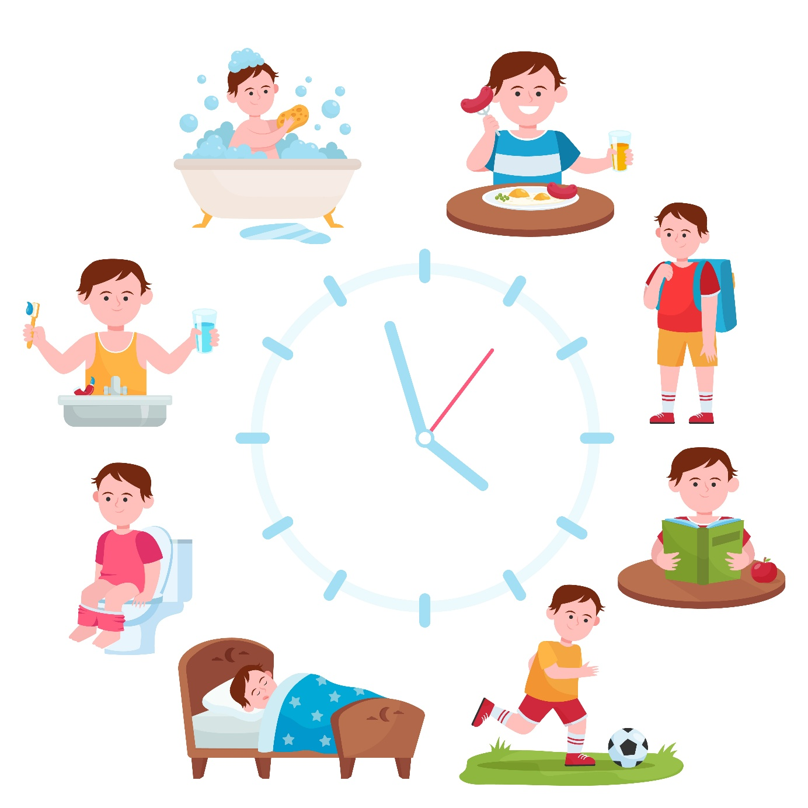
Unit 1: The Importance of Routines for ADHD Management & Common Barriers
1.1 Why routines and time management matter:
Executive function challenges: ADHD often affects planning, organisation, time awareness, transitions, and impulse control.
Predictable structure reduces cognitive load: Children know “what’s next,” lowering anxiety and behavioural dysregulation.
Embedding healthy habits: Consistent routines support sleep, meals, attention, mood, and self-control.
Practical tips: Consistent times for meals, homework, TV, bedtime, and transitions act as key anchors.

Slide 5
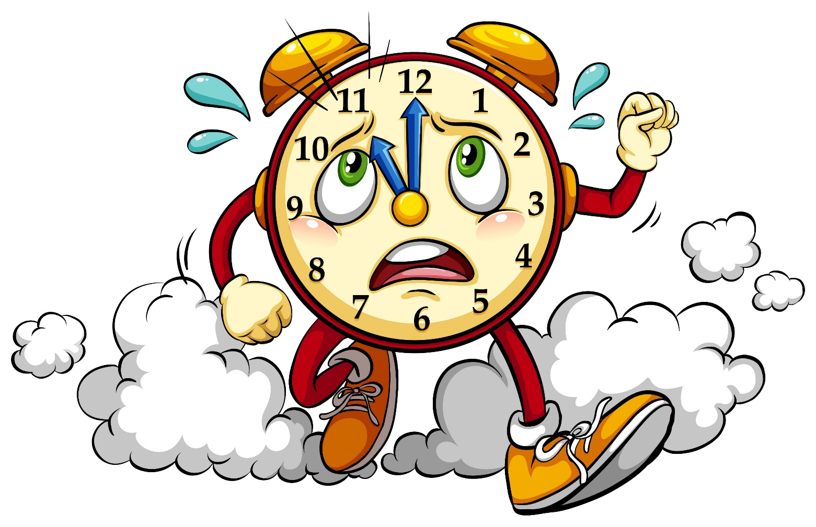
1.2 Common barriers to maintaining routines
Understanding Obstacles and challenges
Underestimating transition times:
Skipping buffers between tasks (e.g., breakfast → brushing teeth) can cause delays, resistance, or meltdowns.
Overloaded schedule:
Packing too many activities in limited time leads to fatigue, stress, and frequent breakdowns.
Time blindness / Time agnosia:
Difficulty perceiving time accurately → tasks take longer than expected, missed deadlines, rushed work.

Slide 6
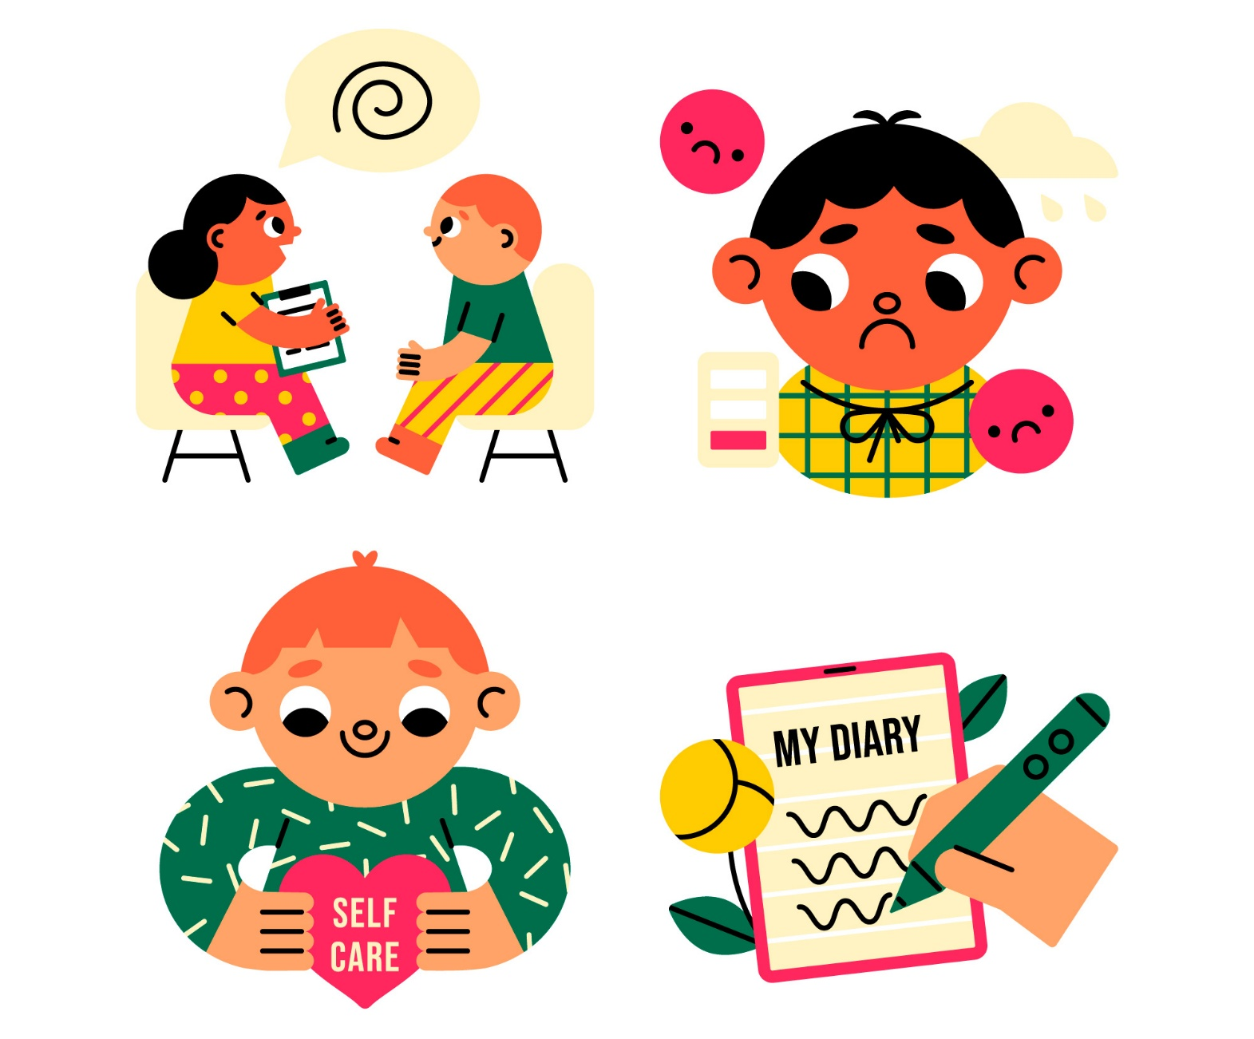
Unit 2: Overcoming Barriers via Step-by-Step Planning Techniques
2.1 Break Routines into Manageable Steps and time estimation
Chunking routines: Break a larger routine (e.g., “get ready for bed”) into small, sequential micro-steps.
Example: 1. Put away toys → 2. Put on pyjamas → 3. Brush teeth → 4. Wash face
Benefits of micro-goals:
Reduces overwhelm
Increases clarity
Supports momentum and completion

Slide 7
2.3 Overcoming resistance and maintaining flexibility
Practical Strategies for Smooth Routines
Co-create routines: Give the child choices (e.g., “Pick pyjamas first or brush teeth first?”)
Use visuals & reminders: Charts, checklists, or icons instead of repeated verbal prompts
Incentivise transitions: Small rewards like stickers or points for smooth step completion
Graceful recovery: Calmly reset if a step is missed: “Let’s pick up from step X”
Consistent reinforcement: Immediate positive feedback helps embed habits
Weekend / variation adaptation: Relax routines slightly but keep anchor times (wake up, meals)
Adjust as needed: Periodically review and tweak steps, buffer times, or order rather than abandoning

Slide 8
Unit 3: Tools — Visual Timetables, Calendars & Checklists to Create Personalised Routines
3.1 Overview of effective tools & digital supports
Tool | Purpose | Examples
Visual timetables / routine boards | Show daily tasks visually; child moves/flips icons for progress | DIY laminated board + Velcro icons
Apps & digital planners | Drag-and-drop schedules, reminders, countdown timers | Thruday: thruday.com
Checklists / step checklists | Visual display of tasks | Hanging pocket charts, laminated checklists
Reminder systems / alarms | Alerts for task transitions | Phone alarms, wearable reminders
Reward charts / token systems | Reinforce adherence | Token per step, reward for full routine

Slide 9
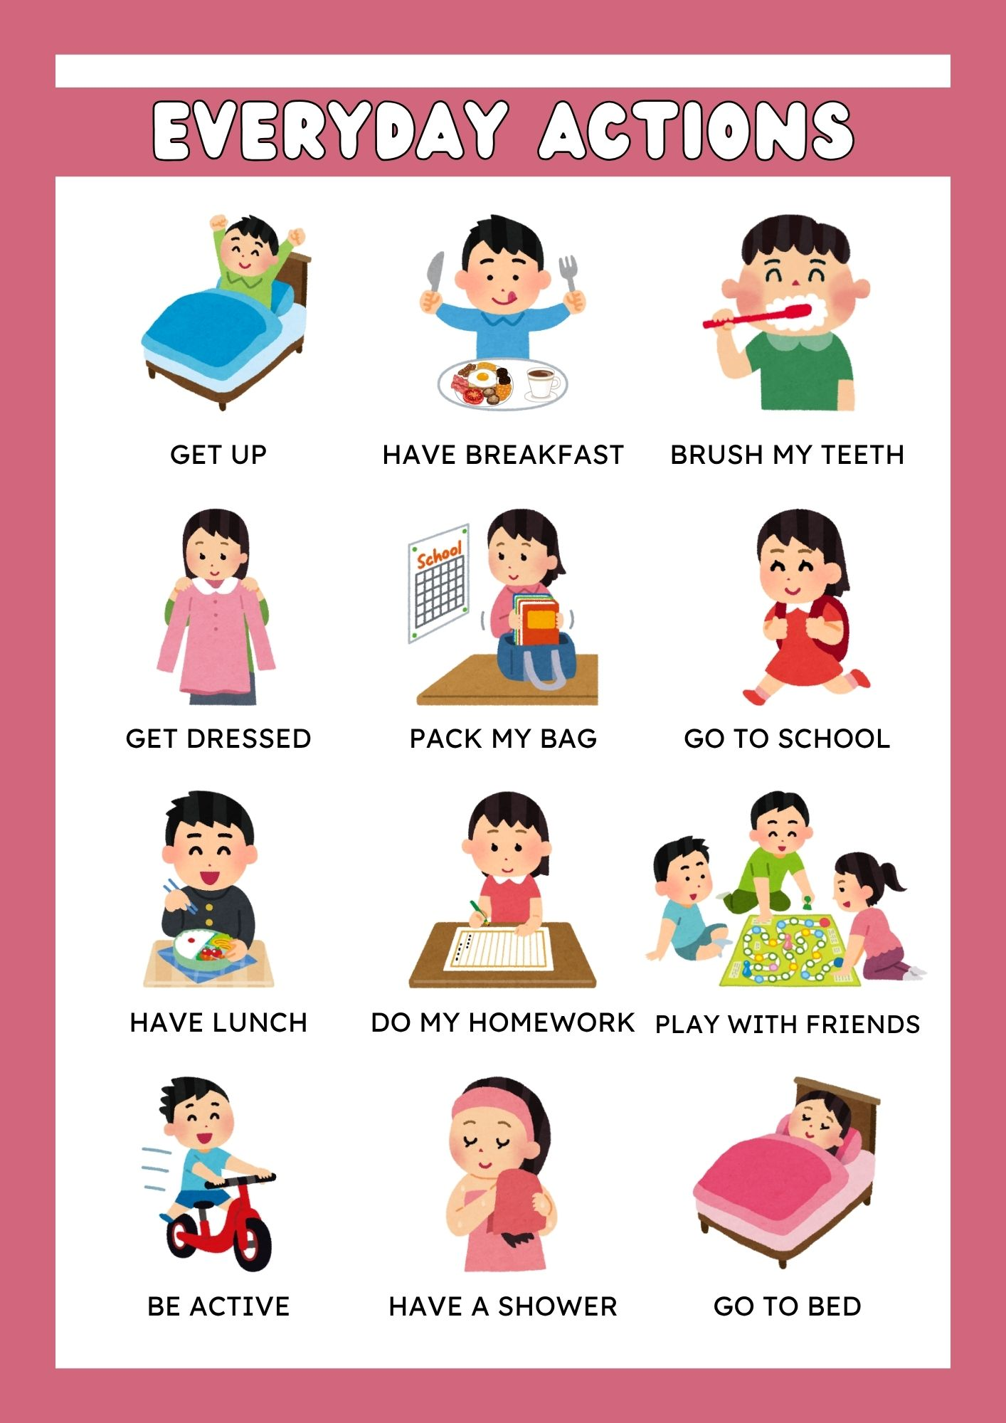
3.2 How to build a visual timetable / routine chart
This unit provides a simple Step-by-step guide on how to build a visual timetable/ routine chart.
An example of a visual schedule is this ‘Everyday Actions’ visual printout (Figure 1.) It can be used as a visual reminder in the childs room to complete their everyday actions, alongside a checklist to check if the tasks have been completed
(Figure 1.)

Slide 10
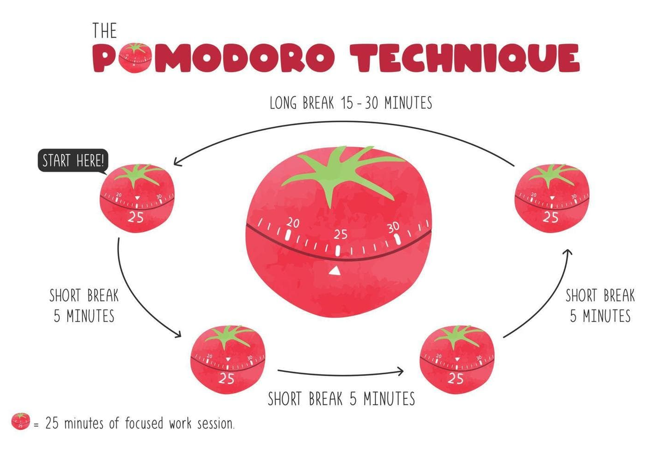
3.3 Creating personalised routines: morning, homework, bedtime
Strategies to support:
Use Pomodoro technique or timed work blocks (e.g. 25 min work → 5 min break, 25 min work → 5 min break, 25 min work → 5 min break, 25 min work → 15-30 min break)
Place priority items first to avoid fatigue
Use visual checklist so child sees what’s left to do
Use silent prompts or timers
Build in accountability / check-ins (parent reviews progress mid-block)
Reserve transition buffer when switching out of homework mode
Pomodoro technique (Image: FreePik)

Slide 11
CASE STUDY 1.1: Building Daily routines for ADHD children
Story:
“BP”’s teachers could not accept his neurodevelopmental deficit, although his mother was supportive, his parents were divorced and his father was absent.
During high school, he was sleeping in on some mornings and feeling bad afterwards. He was smoking and listen to jazz music.
Daily routines were structured around music and supported through music, which emerged as BP’s main motivation and priority—previously suppressed due to community norms.
Rewards were incorporated into the process, with therapy sessions taking place regularly and based on mutual agreements between the therapist and the child.
[See Module 1 for complete Case study]

Slide 12
CASE STUDY 1.1: Building Daily routines for ADHD children
 | Individual Exercise | Group Exercise
1 | What were the key factors contributing to the challenge in case study 1.1? | What tools or solutions can be used to overcome the challenges faced by BP?
2 | What were the basic characteristics of “BP”’s behaviour at home and at school? | How long is needed in order to see the benefits of the routine intervention for ADHD?
3 | How did he succeed to follow the new norms in his life? | Give 3 of the positive results of the daily routine for ADHD.

Slide 13
CASE STUDY 1.2: Time Management for ADHD
Story:
Bubu only got diagnosed with ADHD two years ago. Before her diagnosis, she experienced significant challenges, including losing jobs, friendships, and social connections. In Bubu’s case, her primary difficulty is time management, linked to inattentive ADHD rather than the hyperactive or impulsive type commonly associated with restless children.
Learning to manage her time more effectively has not been easy, however, several strategies have already helped her make meaningful progress:
She sought professional support before making further life changes.
She understood that improvement would take time and committed to at least three months of consistent effort.
She rewarded herself for every small achievement.
She used daily planners with sound reminders and verbally repeated her daily plan.
She rewarded herself each time she took ownership of her time and commitments.
[See Module 1 for complete Case study]

Slide 14
CASE STUDY 1.2: Building Daily routines for ADHD children
 | Individual Exercise | Group Exercise
1 | What were the key factors contributing to the challenge in case study 1.2? | Discuss the most disappointed consequences that happened in “Bubu”s life.
2 | What were the basic characteristics of “Bubu”’s behaviour? | How long is needed in order to see the benefits of the time management for ADHD?
3 | How did she succeed to follow the new norms in life? | Give 3 of the results of the daily routine for ADHD.

