Slide 1





Funded by the European Union. Views and opinions expressed are however those of the author(s) only and do not necessarily reflect those of the European Union or the European Education and Culture Executive Agency (EACEA). Neither the European Union nor EACEA can be held responsible for them.
Project Number: 2024-1-CY01-KA210-ADU-000253720

Slide 2




ABOUT:
PROJECT RESULTS:
The TOGETHE WE CAN Project is dedicated to supporting parents and guardians of children with ADHD, equipping them with the knowledge and tools to foster greater social inclusion for their children. The Project aims to develop a specialised training package that addresses the unique challenges faced by children with ADHD. Additionally, the project provides comprehensive educational materials for adult trainers working on ADHD-related topics, empowering them to deliver impactful training sessions.
Training Methodology defining the structure and content of the specialised training package, Training program and training Materials.
Educational Program and Material for Parents/Guardians of
Children with ADHD
Customised to unique ADHD behaviours
Pilot Training Activity for Parents/Guardians of Children with ADHD in Greece

Slide 3
Module 2: Communication & Instruction Techniques
Module Aim
Learning Objectives
Explain the principles of positive communication with ADHD children.
Demonstrate how tone, body language, and eye contact influence communication.
Identify emotional triggers and avoid common communication pitfalls.
Use step-by-step instruction techniques and active listening to improve compliance and connection.
The aim of this module is to strengthen communication skills for positive interactions and improved compliance with children with ADHD.

Slide 4
Unit 1: The Principles of Positive Communication with ADHD Children
  1.1-1.2 What Is Positive Communication and why this works
Core Principles:
Use short, clear sentences
Emphasise what to do, not what not to do (e.g., “Walk slowly” vs. “Don’t run”)
Recognise and praise all efforts, even small ones
Maintain eye contact and open body language
Stay calm and patient — your tone sets the emotional pace
Give one instruction at a time to avoid overload
Positive communication means being clear, respectful, and supportive — focusing on collaboration instead of criticism or blame.
For children with ADHD, consistent, simple, and emotionally safe communication helps reduce misunderstandings and resistance.

Slide 5

  1.3 Techniques & Tools
Positive Communication Tools for Children with ADHD
Visual Charts & Checklists
Token / Reward Systems
Prompt Cards
Reflection Statements
Goal:
Make expectations clear, visual, and consistent — helping children stay focused, confident, and independent.
Why It Matters:
ADHD affects attention and memory — words alone fade fast. Combining verbal + visual tools makes communication predictable, repeatable, and motivating.
Image: FreePik

Slide 6

Unit 2: The Role of Tone, Body Language, and Eye Contact & Instruction & Listening Techniques
2.1 The Power of Nonverbal Communication
Tone of Voice
Calm, warm, respectful tone = emotional safety
Avoid yelling, sarcasm, or sudden loudness
Use steady volume — firm but friendly
2.2 Clear, Step-by-Step Instructions
How:
Get attention (e.g. “Alex, look at me”)
Give one instruction at a time
Pause — let it sink in
Check understanding (“What’s first?”)
Break tasks into parts
Praise success (“Thanks for doing that so quickly!”)
Body Language & Posture
Face the child, lean slightly forward
Keep arms open and relaxed
Lower to child’s eye level when speaking
Eye Contact
Gentle, brief eye contact — not staring
Pair with warmth (“Thanks for listening”)

Slide 7
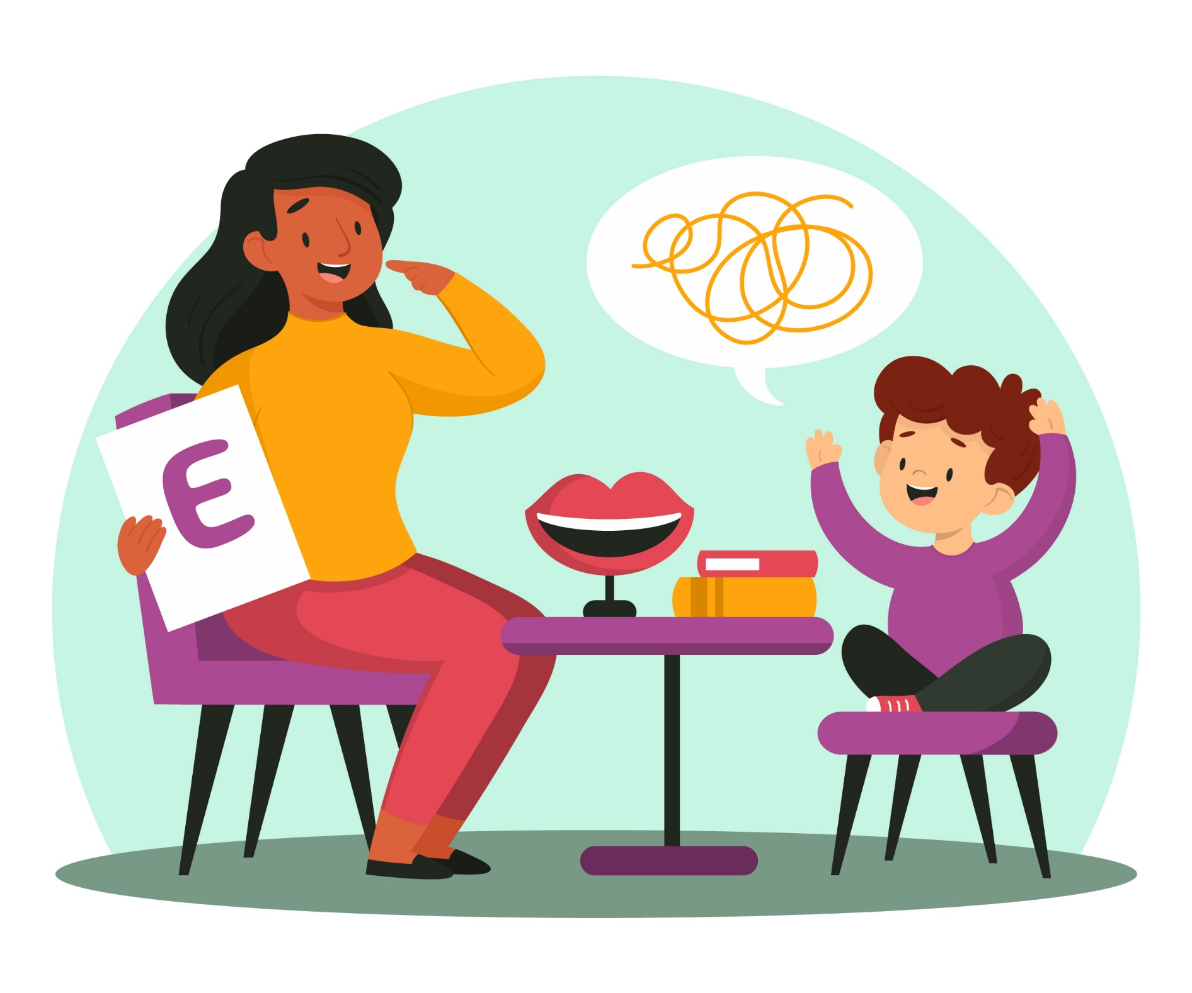

2.3 Active Listening
What It Is:
Active listening means giving full attention — showing genuine interest through words, tone, and body language.
Active Listening Techniques
Remove distractions (put phone away, turn off TV)
Use nonverbal cues: nod, lean in, open posture
Use verbal affirmations: “I see,” “That sounds hard”
Paraphrase: “So you felt upset when…”
Ask open-ended questions: “What happened next?”
Avoid interrupting or rushing to solutions

Slide 8
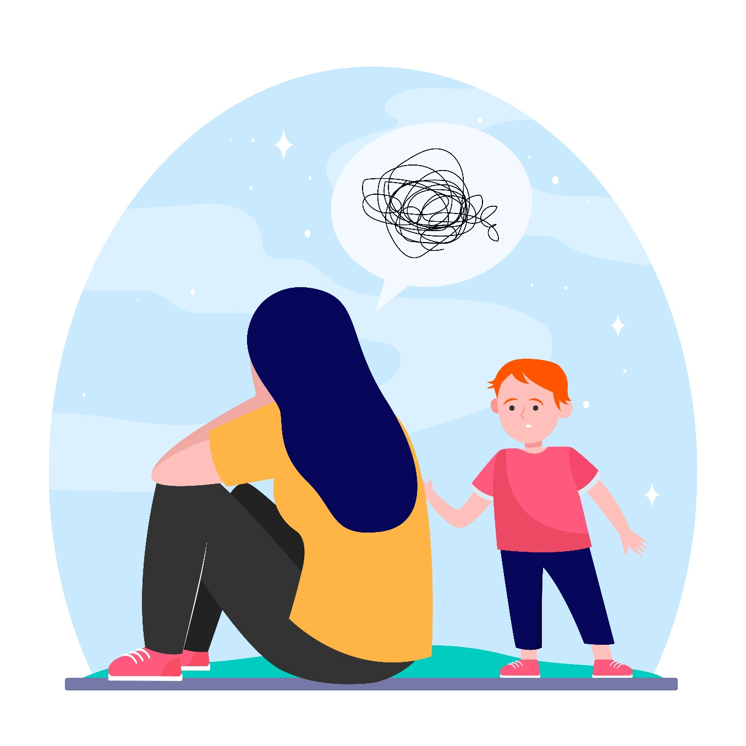
Unit 3: Emotional Triggers & Communication Mistakes
3.1 Recognising Emotional Triggers
When emotions run high:
🔉 Listening decreases
💬 Instructions sound harsher
💔 Self-esteem drops
🔇 Connection is lost
Recognising triggers helps parents:
Pause before reacting
Adjust tone and body language
Model calm, emotional control
Communication often breaks down not from what we say, but how emotions drive it.
Goal:
Recognise triggers in both parent and child to break the cycle and restore calm, respectful communication.

Slide 9
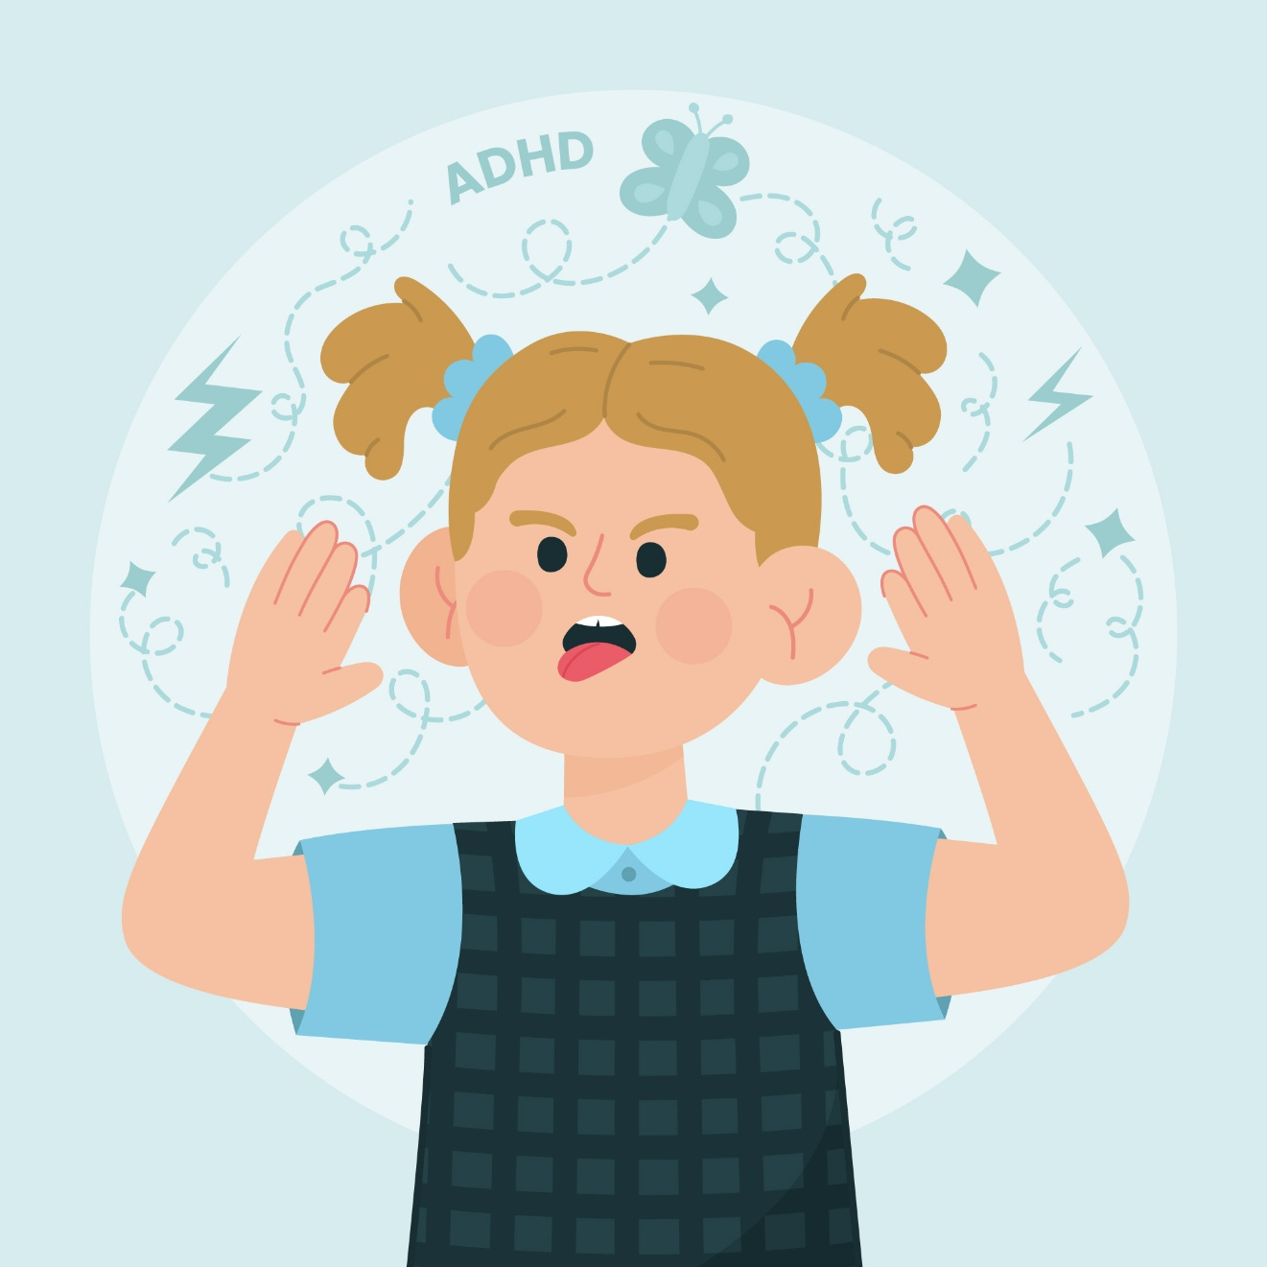
3.2 Why Emotional Triggers Matter in ADHD Communication
Common Triggers and Better Approaches
For Parents:
Repeated requests ignored → Pause, stay calm: “Let’s start together — pick up the first toy.”
Feeling disrespected → “Let’s take a break and talk respectfully when we’re calm.”
For Children:
Criticism or labels → Focus on behaviour: “Let’s tidy the desk together.”
Too many instructions → Break tasks down: “First your book, then your pencil case.”
Yelling or harsh tone → Lower your voice: “I’m not angry — I just need you to listen.”

Slide 10

3.3 Common Communication Mistakes & How to Fix Them
❌ Mistake | Why It Fails | ✅ Better Approach
Giving multiple commands at once | Creates confusion | Give one step, wait, then the next
Using negative commands (“Don’t do that”) | Focuses on what not to do | Phrase positively (“Please walk”)
Yelling / raising voice | Triggers defensiveness | Use a calm, assertive tone
Criticism / labelling (“You’re lazy”) | Hurts self-esteem | Focus on behaviour, not the person
Reinforcing only negative behaviour | Increases attention-seeking | Praise positive behaviour
Ignoring emotional state | Misses root cause | Acknowledge feelings first

Slide 11
CASE STUDY 2.1: Instruction techniques for Neurodivergent Individuals
Since he was 4, his behavior provoked difficulties. Later on, “P” had taken “different” decisions about his sleep, games, school and his future - he would stay home without any close friends, consuming only junk food. The interventions designed by his therapist aimed to create a supportive and effective learning environment tailored to “P’s” neurological profile, particularly in the context of ADHD. These interventions focused on enhancing self-confidence, establishing a structured daily schedule, maintaining routines, and promoting healthy eating habits.
Specific Instructional Techniques:
“Stop, Think, Act” Method: Encouraged reflection before action, helping “P” regulate impulses and make thoughtful decisions.
Pre-Commitment Strategies: Fostered planning and adherence to tasks by creating structured commitments in advance.
Frequent Check-ins: Regular monitoring and guidance ensured tasks were on track and provided immediate feedback.
Play the Story Technique: Used narrative and role-play to make learning engaging, promote comprehension, and reinforce desired behaviours.
[See Module 2 for complete Case study]

Slide 12
CASE STUDY 2.1: Instruction techniques for Neurodivergent Individuals
 | Individual Exercise | Group Exercise
1 | What were the key factors contributing to the challenge in case study 2.1? | Which are the instruction techniques ?
2 | What objectives were established following the intervention to address “P”’s developmental and behavioral challenges? | Give the key ways to instruct the techniques for ADHD individuals.
3 | How did he succeed to follow the new norms at his life? | Give 2 techniques used by “P” to improve his ADHD.

Slide 13
CASE STUDY 2.2: Communication techniques
“D” is a tall and beautiful adolescence who has anxiety, and who was willing to start something new but after 6 minutes, she changes activity. She always accepted game proposals and she was setting goals - without the experience of success. To improve “D”s communication skills, her parents used to invite a friend at their house. They were focusing on her interests to help with engagement, using clear, direct, and simple language, breaking down instructions into small steps, providing visual aids, offering choices, with role-playing and giving immediate, positive feedback to build skills and understanding. Her parents gave their undivided attention, distraction-free environment. “D” has been using strategies like breaking down tasks, establishing a structured and, using timers and visual aids with the help of her parents. This helped her overall communication with her parents, making her express her feelings in a clearer way and she now had a better vision of her upcoming tasks. She could also incorporate physical activity and frequent breaks. It was an important time when they were taking strategic breaks for 2 minutes, with incorporate movement, establishing routines and giving rewards after any try.
[See Module 2 for complete Case study]

Slide 14
CASE STUDY 2.2: Communication techniques
 | Individual Exercise | Group Exercise
1 | What were the key factors contributing to the challenge in case study 2.2? | Discuss 2 other communication techniques that could be useful.
2 | Which were the techniques that “D” has used to overcome her communication deficits? | How long is needed in order to see the benefits of the intervention?
3 | Which is the first tip in order to prove that the communication techniques are useful? | What is one communication technique that helps children with ADHD stay engaged during conversations?

