Slide 1




Funded by the European Union. Views and opinions expressed are however those of the author(s) only and do not necessarily reflect those of the European Union or the European Education and Culture Executive Agency (EACEA). Neither the European Union nor EACEA can be held responsible for them.
Project Number: 2024-1-CY01-KA210-ADU-000253720

Slide 2




ABOUT:
PROJECT RESULTS:
The TOGETHE WE CAN Project is dedicated to supporting parents and guardians of children with ADHD, equipping them with the knowledge and tools to foster greater social inclusion for their children. The Project aims to develop a specialised training package that addresses the unique challenges faced by children with ADHD. Additionally, the project provides comprehensive educational materials for adult trainers working on ADHD-related topics, empowering them to deliver impactful training sessions.
Training Methodology defining the structure and content of the specialised training package, Training program and training Materials.
Educational Program and Material for Parents/Guardians of
Children with ADHD
Customised to unique ADHD behaviours
Pilot Training Activity for Parents/Guardians of Children with ADHD in Greece

Slide 3

MODULE 4:
SCHOOL COLLABORATION & ADVOCACY
Module Aim & Learning Objectives
To equip parents to work with educators and advocate effectively for their child’s needs.
Understand educational rights & support frameworks for children with ADHD
Communicate ADHD-related needs to teachers using effective strategies
Create and collaborate on Individual Education Plans (IEPs)
Advocate constructively for their child’s rights in the school system.

Slide 4





Unit 1:
UNDERSTANDING EDUCATIONAL RIGHTS & SUPPORT FRAMEWORKS
Core Highlights
International, EU, and national laws
Rights: access to inclusive education and reasonable accommodations
School’s support for personalized learning approaches
Understanding educational rights empowers parents to advocate effectively for their child.

Slide 5






Unit 1:
UNDERSTANDING EDUCATIONAL RIGHTS & SUPPORT FRAMEWORKS
Educational Rights in the EU Context
UNCRPD Articles 7 & 24
What rights exist in your country that you were previously unaware of?
  right to inclusive education
EU Disability Strategy 2021–2030
  accessibility & equal participation
Law 113(I)/1999
  assessments & IEPs
Law 3699/2008
  ADHD under SEN
Pre-school & School Education Act (2015)
  individualized support

Slide 6

Unit 1:
UNDERSTANDING EDUCATIONAL RIGHTS & SUPPORT FRAMEWORKS
Individual Education Plans (IEPs)
Strengths & learning preferences
Support needs (academic, behavioral, emotional)
Accommodations
Measurable goals
Review schedule
Focus on strengths during meetings
Suggest strategies that work at home
Request regular reviews
Practical Tips for Parents

Slide 7

Unit 2:
ADHD TRAITS & RAISING AWARENESS AMONG TEACHERS
ADHD in the Classroom
Difficulty sustaining attention
Forgetting homework/materials
Trouble following multi-step instructions
Emotional impulsivity
Restlessness
BUT… also
strengths creativity, problem-solving, curiosity, energy.

Slide 8

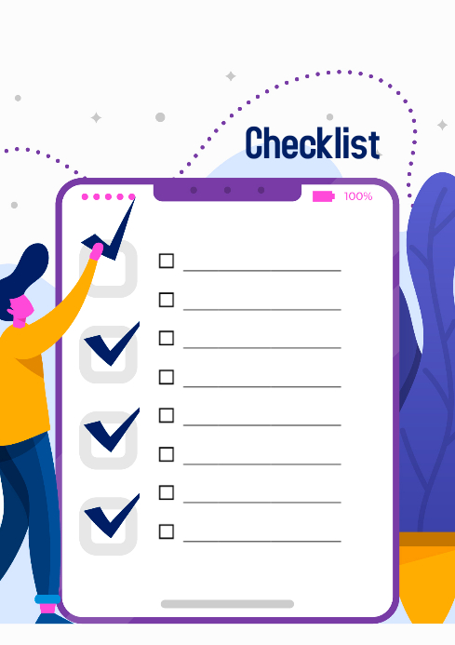
Unit 2:
ADHD TRAITS & RAISING AWARENESS AMONG TEACHERS
Raising Awareness & Building Empathy
Opening a Dialogue:
“I’d love to collaborate on strategies that work both at home and in class.”
Requesting Adjustments:
“Could we try giving shorter instructions or written reminders?”
Addressing Behavior:
“Can we explore triggers together and agree on preventive support?”
IEP Review:
“Can we schedule a follow-up to discuss progress and next steps?”
Identify a supportive staff member
Checklist for parents
Scripts
for
Effective Communication
Share practical tips rather than theory
Provide real examples from home
Follow up with appreciation

Slide 9

Unit 3:
PRODUCTIVE PARTNERSHIPS & ADVOCACY IN ACTION
Building Trust
Transparency
Respect & empathy
Consistent communication
Shared goals
Tip:
Start conversations with appreciation:
Thank you for your efforts with my child

Slide 10




Unit 3:
PRODUCTIVE PARTNERSHIPS & ADVOCACY IN ACTION
Advocacy Skills for Parents
Preparing notes and relevant documents
Being clear about requests
Staying calm and professional
Following up politely and consistently
Using evidence (observations, reports, IEP notes)
Situation →
What is happening?
Request →
What support is needed?
Evidence →
What supports your request?
Follow-up →
Who and when?
Advocacy Action Template

Slide 11
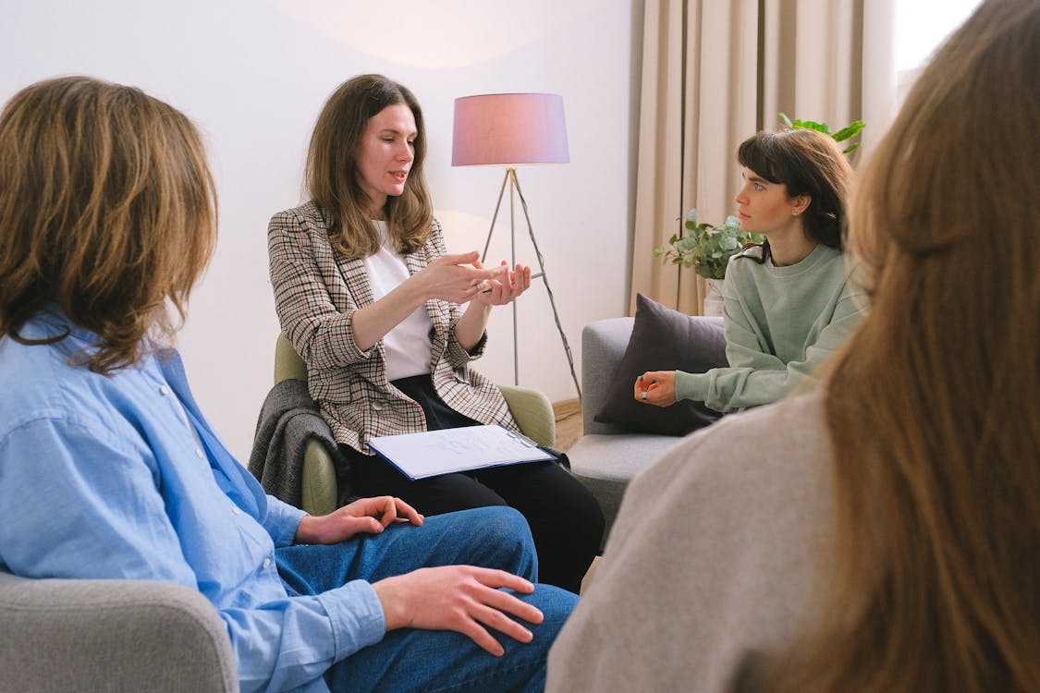
Unit 3:
PRODUCTIVE PARTNERSHIPS & ADVOCACY IN ACTION
Collaborating at School and System Level
Parents can:
Join or form parent support groups
Promote ADHD-sensitive practices (movement breaks, flexible seating)
Suggest teacher workshops
Collaborate with school boards
Connect with national ADHD associations
What is one small advocacy action you can take this month?

Slide 12
CASE STUDY 4.1.
The Challenge / Problem
BB, a 6-year-old student in Greece, showed the following pattern from the first weeks of school: her teacher noticed that BB could not remain seated, spoke out of turn, and avoided interacting with classmates unless she felt frustrated, in which case she pushed or shouted. At home, her parents described chaotic routines, resistance to sleep, and long hours spent on digital games.
Collaboration between parents, teachers, the school psychologist and ADHD professionals. After the diagnosis “At-risk for ADHD,” a European model was used to design a plan for action: movement breaks, a visual schedule, clear 2-step instructions, and guidance during social play by teachers. At home, parents followed a simplified routine, reduced screen time, and practiced short communication games. Specialists monitoring her progress, sharing updates through online meetings and resources. Improvements within weeks.
Details provided in the full Module Content
The Solution

Slide 13

CASE STUDY 4.1.
Exercise / Question
 | Individual Exercise | Group Exercise
1 | What were the key factors contributing to the challenge in case study 4.1? | How has the school collaboration been organized?
2 | What were the main early signs that BB was at risk for ADHD? | Could you add some more ways?
3 | What were two key interventions implemented for BB at school? | Is there any key aspect of collaboration?

Slide 14
CASE STUDY 4.2.
The Challenge / Problem
CC is a high-school student with inattentive-type ADHD, who struggled with focus, stress regulation, time management, and task completion. At home, she attempted to study but could not recall what the teacher had explained earlier in the day. CC showed exceptional strengths in theatre: she remembered scripts effortlessly, performed dialogues with precision. However, her teachers were concerned because her academic performance did not improve. They suggested stricter study routines or transferring her to a less demanding school.
The Solution
CC’s parents reached out to the ADHD advocacy group. Through the combined advocacy of the therapist, family, and ADHD organizations, the school realized its responsibility to support CC rather than move her. Together, they created a collaborative plan: teachers agreed to offer structured notes, shorter assignments, and clear expectations, while CC used self-advocacy strategies to ask for help when needed.
Details provided in the full Module Content

Slide 15

CASE STUDY 4.2.
Exercise / Question
 | Individual Exercise | Group Exercise
1 | What were the key factors contributing to the challenge in case study 4.2? | Explain the basic benefits of advocacy.
2 | How did CC demonstrate her strengths despite ADHD challenges? | What strategies were implemented to support CC at school?
3 | Why was advocacy necessary in CC’s case?? | Discuss the advocacy goals.

Slide 16
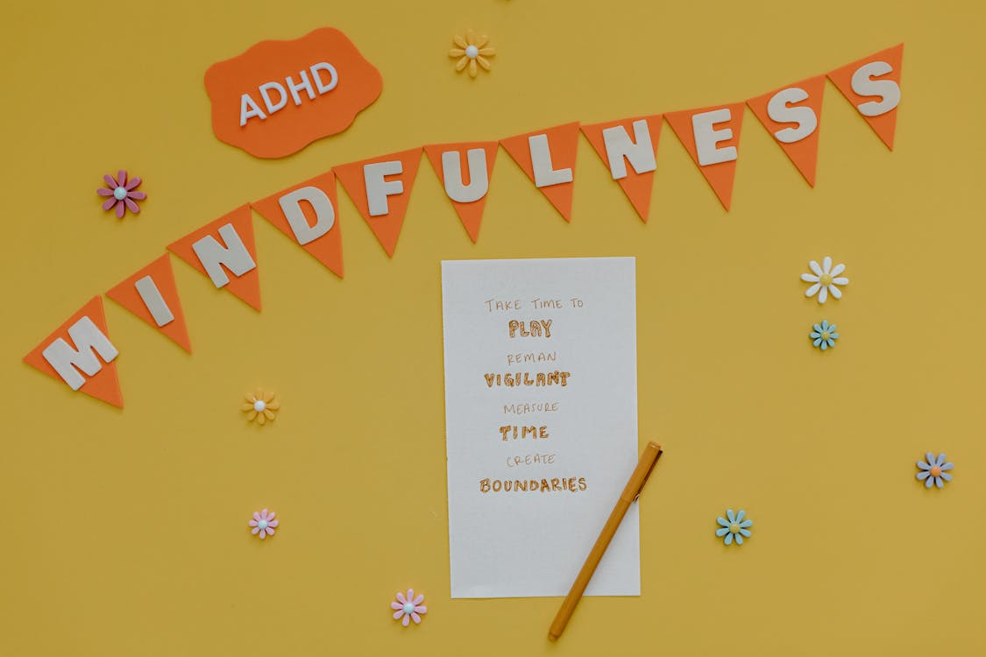
MODULE 4:
SCHOOL COLLABORATION & ADVOCACY
Key takeaways
Children with ADHD have strong educational rights across the EU.
Collaboration improves when parents and teachers share understanding.
IEPs are powerful tools when kept practical and regularly reviewed.
Advocacy is respectful, consistent communication—not confrontation.
Small accommodations can create major improvements.
Every partnership you build today shapes a more inclusive school environment for tomorrow.

Slide 17
THANK YOU FOR YOUR PARTICIPATION!
For more information:
Visit the TOGETHER WE CAN project Facebook or contact your local partner organization

