Slide 1




Funded by the European Union. Views and opinions expressed are however those of the author(s) only and do not necessarily reflect those of the European Union or the European Education and Culture Executive Agency (EACEA). Neither the European Union nor EACEA can be held responsible for them.
Project Number: 2024-1-CY01-KA210-ADU-000253720

Slide 2




ABOUT:
PROJECT RESULTS:
The TOGETHE WE CAN Project is dedicated to supporting parents and guardians of children with ADHD, equipping them with the knowledge and tools to foster greater social inclusion for their children. The Project aims to develop a specialised training package that addresses the unique challenges faced by children with ADHD. Additionally, the project provides comprehensive educational materials for adult trainers working on ADHD-related topics, empowering them to deliver impactful training sessions.
Training Methodology defining the structure and content of the specialised training package, Training program and training Materials.
Educational Program and Material for Parents/Guardians of
Children with ADHD
Customised to unique ADHD behaviours
Pilot Training Activity for Parents/Guardians of Children with ADHD in Greece

Slide 3
MODULE 5: Emotional Regulation, Behaviour & Social Inclusion
Module Aim
The aim of this module is to develop learners understanding of emotional regulation with ADHD and its impact on behaviour and social inclusion. The module explores how emotional dysregulation influences adaptive behaviour, decision-making, and interpersonal relationships, and how targeted interventions—such as self & social learning, art, drama, and inclusive practices—can support emotional well-being, positive behaviour, and meaningful social participation.
Learning Objectives:
Understand the role of emotional regulation and dysregulation in ADHD.
Identify the behavioural and social impacts of emotional dysregulation.
Analyse the relationship between emotional regulation, adaptive behaviour, and social inclusion.
Apply evidence-informed intervention strategies to support emotional regulation, positive behaviour, and social participation in children with ADHD.

Slide 4
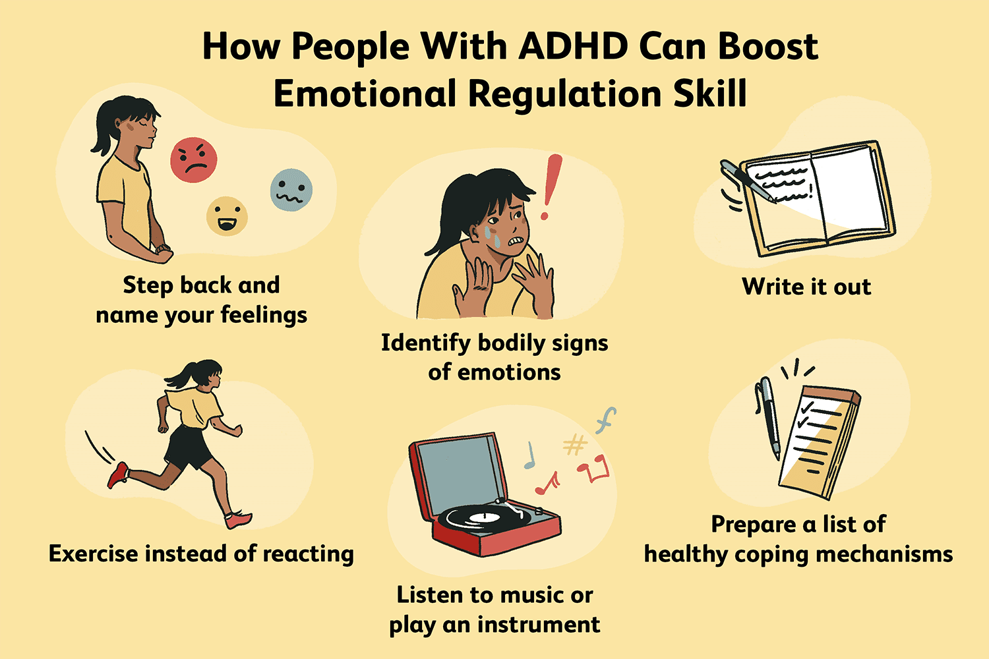
UNIT 1: Emotional, behavioral and social impact of ADHD
  Unit 1.1 What is Emotional Dysregulation?
Emotional dysregulation is common in people with ADHD due to a combination of factors, including executive function deficits, impulsiveness, hyperactivity, stress, comorbid disorders, and medication side effects.

Slide 5

UNIT 1: Emotional, behavioral and social impact of ADHD
1.2. Emotional dysregulation and behavioural impact
Here are some examples:
Experiencing intense emotions, like anger outbursts or high anxiety
Crying in response to a variety of feelings, even happiness
Having mood swings and unpredictable emotions
Having a low tolerance for frustrating situations

Slide 6
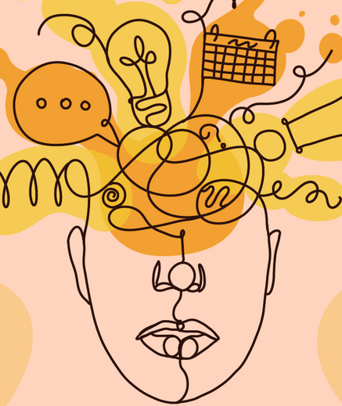
UNIT 1: Emotional, behavioral and social impact of ADHD
1.3. Emotional dysregulation and social impact
Emotional dysregulation can impact the social life of children with ADHD.
Low frustration tolerance affects relationships.
Risk of peer rejection and exclusion.
Supportive environments can reduce risk.

Slide 7
UNIT 2: Emotional and behavioral characteristics
2.1. Controlling and managing emotional responses
A common symptom of ADHD, is characterized by difficulty in controlling and managing emotional responses.
Why this happens
1. Brain development: In children with ADHD, key brain areas responsible for emotional regulation develop differently or more slowly, particularly: the amygdala and the frontal cortex, which are involved in emotional reactions and regulation.
2. Stress Sensitivity and Emotional Overload.

Slide 8
UNIT 2: Emotional and behavioral characteristics
2.2. Behavioural Characteristics of ADHD
Innattention
Making careless mistakes
Difficulty sustaining focus or staying on task
Being easily distracted
Hyperactivity
Fidgeting, tapping, or squirming
Difficulty sitting still, for example, in class or during meals
Feeling restless
Impulsivity
Blurting out answers before questions are completed
Difficulty waiting for one's turn
Interrupting or intruding on others

Slide 9

UNIT 2: Emotional and behavioral characteristics
2.3. Behavioural treatments
1. Responding to Tantrums Through Co-Regulation. Example:
When a child has a tantrum after being told “no,” the parent stays calm, lowers their voice, and gets to the child’s eye level. Instead of arguing or giving in, the parent says:
“I see you’re very upset. Let’s take three slow breaths together.”
Once the child is calm, the parent briefly explains the limit and offers a choice:
“You can calm down here with me or take a short break and come back.”

Slide 10

UNIT 3: Social Inclusion and Social Participation
3.1. Social Inclusion and Challenges
Common Social Challenges in Children with ADHD:
Difficulty reading social cues
Unstable or short-lived friendships
Social rejection or exclusion
Internal challenges
Misunderstandings
3.2. Factors Supporting Social Inclusion:
Peer support
Reassurance of self-worth
Inclusive environments
Inclusive education
Balanced adult support

Slide 11

UNIT 3: Social Inclusion and Social Participation
3.3. Practical Strategies for Parents to Improve
Social Inclusion
Prepare Children for Social Situations
Address Peer Biases Through Collaboration
Teach Emotional Repair, Not Perfection
Encourage Strength-Based Participation

Slide 12
CASE STUDY 5.1 : Behavioural regulation & Social Inclusion “S”
“S” is clever, obedient, and shows basic social skills, though she struggles with organisation, personal care, and processing sensory stimuli, making it difficult for her to engage with others for long periods. For several years, her parents sought professional help, including psychologists and speech therapists, and she practiced martial arts, but progress was slow. At school she had very poor academic presence.
Structured routines at school and home, short study breaks, group activities like dance, and reward-based reinforcement helped her begin managing emotions, reducing reliance on mobile devices and chocolates for comfort.
With guided support from her parents and therapists, she gradually learned to engage with peers, participate in team activities, and express herself more confidently.
[See Module 5 for complete Case study]

Slide 13
CASE STUDY 5.1 : Behavioural regulation & Social Inclusion “S”
 | Individual Exercise | Group Exercise
1 | What were the key factors contributing to the challenge in case study 5.1? | Which are the 2 primitive goals that helped “S”?
2 | How can family involvement improve outcomes for a child with ADHD like “S”? | Give 2 extra suggestions for “S” intervention apart from the ones mentioned
3 | Which is the way for the child with ADHD to succeed in the social inclusion? | Why are structured routines important for “S”?

Slide 14
CASE STUDY 5.2 : Emotional & Social Deficit with hyperactivty
“A” is a nice boy with blond hair, polite, nice looking and clever! He is hyperkinetic by moving all the time without purpose. Although he practices martial arts for the last 2 years, he was negative about playing with others and had social skills only at the beginning of the practice. At home, he played with the smartphone and started studying at 8pm. When there was a need for a break, his mother shouted at him as she couldn’t understand the son’s difficulty and needs.
His parents asked for help from a developmental psychologist and a therapist. After the appropriate testing and the clinical observation, a growing interest was evaluating in family history of ADHD, mental health conditions and cortical activation.
The preferable techniques are: Spontaneous expression at Dramatotherapy or Animal Play with non-verbal communication (Animal play involves participants embodying animals through movement, sound, and behaviour. This can occur in therapeutic, educational, or play-based settings.) Discussion with child’s individual experience, Rewards upon task completion and Parental cooperation with the therapist.
[See Module 5 for complete Case study]

Slide 15
CASE STUDY 5.2 : Emotional & Social Deficit with hyperactivty
 | Individual Exercise | Group Exercise
1 | What were the key factors contributing to the challenge in case study 5.2? | List 3 ways to overcome this challenge using the tools and solutions from this module.
2 | How was the parental reactions? | Which were the 2 major difficulties?
3 | How can the parent help a 7 year old child, when there is emotional and social deficit added with hyperactivity? | What key behavioral characteristics indicated that the child was at risk for ADHD?

