Slide 1




Funded by the European Union. Views and opinions expressed are however those of the author(s) only and do not necessarily reflect those of the European Union or the European Education and Culture Executive Agency (EACEA). Neither the European Union nor EACEA can be held responsible for them.
Project Number: 2024-1-CY01-KA210-ADU-000253720

Slide 2




ABOUT:
PROJECT RESULTS:
The TOGETHER WE CAN Project is dedicated to supporting parents and guardians of children with ADHD, equipping them with the knowledge and tools to foster greater social inclusion for their children. The Project aims to develop a specialised training package that addresses the unique challenges faced by children with ADHD. Additionally, the project provides comprehensive educational materials for adult trainers working on ADHD-related topics, empowering them to deliver impactful training sessions.
Training Methodology defining the structure and content of the specialised training package, Training program and training Materials.
Educational Program and Material for Parents/Guardians of
Children with ADHD
Customised to unique ADHD behaviours
Pilot Training Activity for Parents/Guardians of Children with ADHD in Greece

Slide 3
MODULE 6 Healthy living: Nutrition, Physical activities & Sleep
Module Aim
Learning Objectives
By the end of this module, parents will be able to:
Explain how nutrition, movement, and sleep influence ADHD symptoms and emotional regulation.
Apply practical, age-appropriate strategies to support healthy habits at home.
Teach children with ADHD how to participate actively in their own healthy routines.
Maintain consistency and motivation using structure, predictability, and positive reinforcement.
The aim of this module is to empower parents of children with ADHD to understand how daily lifestyle habits—nutrition, physical activity, and sleep—affect attention, emotional regulation, and behavior. Parents will learn how to translate this knowledge into practical routines and strategies that fit real family life and support their child’s self-regulation, well-being, and social functioning.

Slide 4

UNIT 1: Nutrition and ADHD
1.1. Why Nutrition Is Especially Important in ADHD
Irregular meals and sugar worsen symptoms
Energy, mood, and attention are affected
Timing and structure of meals are essential
1.2. Practical Strategies Parents Can Use
Fixed meal times
Breakfast every day
Protein in every meal
Reduce sugar without conflict
Involve the child

Slide 5

UNIT 1: Nutrition and ADHD
1.3. Things to Avoid
Using food as punishment or reward.
Long lectures about “good” and “bad” food.
Expecting immediate change.
Parent Reflection Checklist (Weekly)
☐ Were meals predictable this week?
☐ Did sugar affect my child’s mood or focus?
☐ What worked well?
☐ What small change can we try next week?

Slide 6
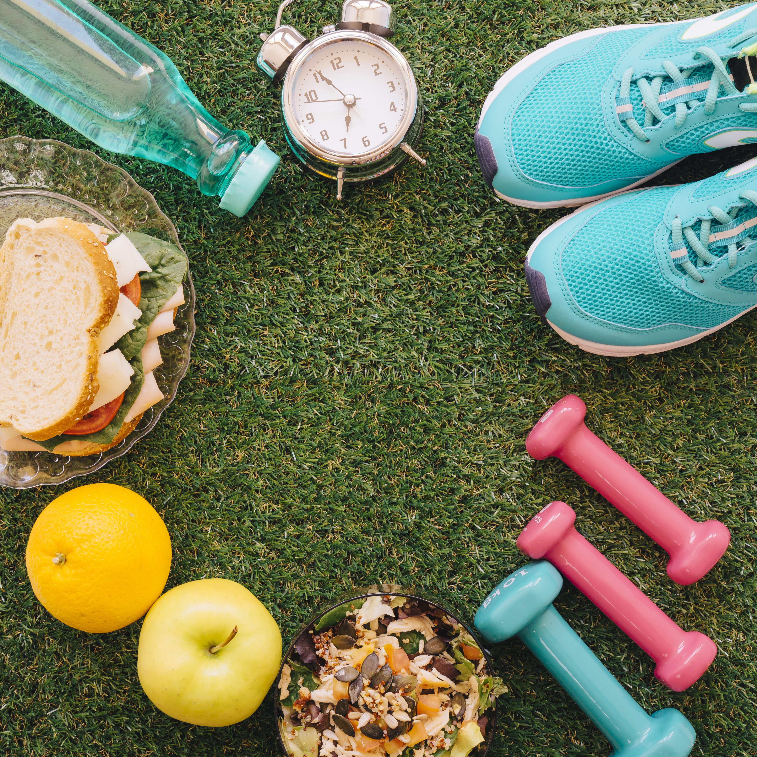
UNIT 2: Physical Activity and ADHD
2.1 Why Physical Activity Is Essential in ADHD
Movement helps children with ADHD:
release excess energy,
regulate emotions,
improve attention,
build self-esteem.

Slide 7
UNIT 2: Physical Activity and ADHD
Practical Strategies Parents Can Use:
1. Choose the Right Type of Activity
Not all sports are suitable for every child.
Often helpful activities:
Swimming
Martial arts
Athletics
Cycling
Dance
Structured team sports with support
2.2 What Parents Should Aim For
Daily movement (not necessarily sports)
Structured and predictable activities
Focus on enjoyment and success

Slide 8
UNIT 3: Sleep and ADHD
3.1. Why Sleep Is Often Difficult in ADHD
Night alertness and sensory sensitivity
Poor sleep increases impulsivity and reactivity
Sleep directly affects behaviour and focus

Slide 9
UNIT 3: Sleep and ADHD
Tips for Consistent sleep
3.2 Practical Strategies Parents Can Use
Fixed bedtime and wake-up time
Calm bedtime routine
Screens off before bed
Optimised sleep environment
Medication timing if needed
1. Stick to a sleep schedule and routine
2. Avoiding screens before bed
3. Practicing relaxation techniques
4. Pay attention to what you eat and drink
5. Create a restful environment
6. Limit daytime naps
7. Include physical activity in the daily routine
8. Manage stress
9. Have positive thinking during the day.

Slide 10

Adapting a Healthy Lifestyle with ADHD
Healthy Living with ADHD involves
a holistic, multi-modal approach combining routine, physical health (sleep, exercise, diet), emotional well-being and a supportive environment.

Slide 11
CASE STUDY 6.1 Healthy Living:Nutrition and sleep
“F” is a polite boy but his anxiety and stress are evident in his voice and body language, particularly at the beginning of our meetings. He often stays awake until 12:30–1:00 a.m., which contributes to his irritability and social withdrawal. “F” has no close friends and is rarely invited to social events.
After thorough clinical observation and assessment, the intervention focused on improving self-esteem, social skills, and attention through healthy nutrition and sleep regulation. “F” began following structured daily routines, including a balanced diet and fixed sleep schedule. Nutritional guidelines emphasized sugar-free, natural or organic foods, avoidance of artificial products, stable meal times, and adherence to a Mediterranean-style diet. Evening routines included a 20-minute shower at 21:30–22:00, after which he prepared for bed without electronic devices.
To reinforce these habits, behavioural strategies were employed, including:
Positive reinforcement for adherence to diet and sleep routines.
Parental cooperation to maintain consistency and support progress.
Engaging activities, such as drawing or photographing himself during meals, to build awareness and motivation.
[See Module 6 for complete Case study]

Slide 12
CASE STUDY 6.1 Healthy Living:Nutrition and sleep
 | Individual Exercise | Group Exercise
1 | What were the key factors contributing to the challenge in case study 6.1? | Write the first 2 tips for a child with ADHD to be willing to adapt healthy living
2 | What were the goals after having checked “F” ‘s deficits? | How long is needed to see the benefits for sleeping because of the intervention?
3 | How did he succeed to follow the new norms at his life? | How can healthy recipes support a child with ADHD in developing better habits?

Slide 13
CASE STUDY 6.2 Healthy Living with Physical activities
T” is a polite, well-mannered boy with a strong natural interest in sports—especially football. “T” was also living with ADHD, which made it difficult for him to cooperate with multiple peers at once, sustain attention, and manage social interactions during team sports. Six years ago, after being identified as at risk for ADHD, “T” received support from a psychologist and an occupational therapist using a computerized platform. Despite 14 months of work, progress was minimal. Two years ago, his parents sought help from another specialist who encouraged “T” to continue with football, honoring his preferences. However, he discontinued after one month due to difficulties managing the demands of the team environment.
Four months ago, “T” and his parents visited I-PAIDIs offices. Following detailed assessment and clinical observation, a holistic plan was developed focusing on healthy living practices, improved social interaction, and enhanced attention through an appropriate physical activity:
Regular physical exercise to regulate hyperactivity
Behavioral rewards to encourage persistence and healthy routines
Cooperative strategies between parents and the therapist
Building confidence through achievable physical challenges
After one month of integrated intervention—including structured physical activity, healthy-habit reinforcement, reward systems, and consistent parental collaboration—“T” showed significant improvements. He began studying independently, following his daily routine more reliably, and became more active physically.
[See Module 6 for complete Case study]

Slide 14
CASE STUDY 6.2 Healthy Living with Physical activities
 | Individual Exercise | Group Exercise
1 | What were the key factors contributing to the challenge in case study 6.2? | Write the adding benefit of the taking part in appropriate physical activities for ADHD
2 | Which were the challenges in “T” ‘s life? | How long is needed in order to see the benefits for ADHD because of the physical activities intervention?
3 | How did he succeed in following the new norms in his life? | Why was choosing the right physical activity important for “T”?

